Slide 1
Resource Management
TOPIC 6.0 – RESOURCE MANAGEMENT
TOPIC 6
6.1.1-6.1.4: Resources

Slide 2
AGENDA
THE AGENDA
Resource Discussion
Topic 2 Review
Device Discussion
Limitations of devices

Slide 3

REVIEW REVIEW REVIEW REVIEW REVIEW REVIEW
THE WARM-UP QUESTION
Construct a truth table for the following logical statement
(p^q)v(r^q)

Slide 4
REVIEW REVIEW REVIEW REVIEW REVIEW REVIEW
THE WARM-UP ANSWER
Inputs |  |  |  |  | Output
p | q | r | p^q | r^q | (p^q)v(r^q)
F | F | F | F | F | F
F | F | T | F | F | F
F | T | F | F | F | F
F | T | T | F | T | T
T | F | F | F | F | F
T | F | T | F | F | F
T | T | F | T | F | T
T | T | T | T | T | T

Slide 5
TOPIC 6.1.1 – IDENTIFICATION OF RESOURCES
RESOURCES
System Resources – hardware, software, trained personnel, supporting infrastructure
Managing these resources is a critical factor
Most resources are limited in one way or another and must be managed well

Slide 6
TOPIC 6.1.1 – IDENTIFICATION OF RESOURCES
CPU SPEED
The CPU is the main processor of the computer
Different CPUs can compute things at different speeds
This is determined in part by how efficient the design is
CPU speed is also based on clock speed – the frequency at which the processor runs
Measured in hertz, but modern processors run in the Gigahertz range (GHz)

Slide 7
TOPIC 6.1.1 – IDENTIFICATION OF RESOURCES
PRIMARY MEMORY
Primary Memory – all data and instructions must be stored in the primary memory
Connected directly to processor
Gives processor data & instructions through the fetch, decode, execute cycle
Also referred to as Immediate Access Store

Slide 8
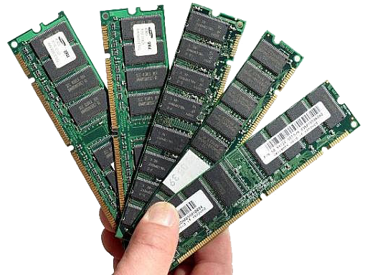
TOPIC 6.1.1 – IDENTIFICATION OF RESOURCES
RAM AND CACHE
Recall that there are two different types of RAM
SRAM – Static RAM used for cache
Faster, small capacity, pricier, placed in between CPU and DRAM
DRAM – Dynamic RAM used for system Primary Memory (RAM as we think of it)
Cheaper, larger capacity, slower

Slide 9
TOPIC 6.1.1 – IDENTIFICATION OF RESOURCES
BANDWIDTH
Bandwidth – speed at which data can travel from SRAM and DRAM to the CPU
Essential for CPU performance
Measured in bytes/second
Often Megabytes or Gigabytes per second

Slide 10
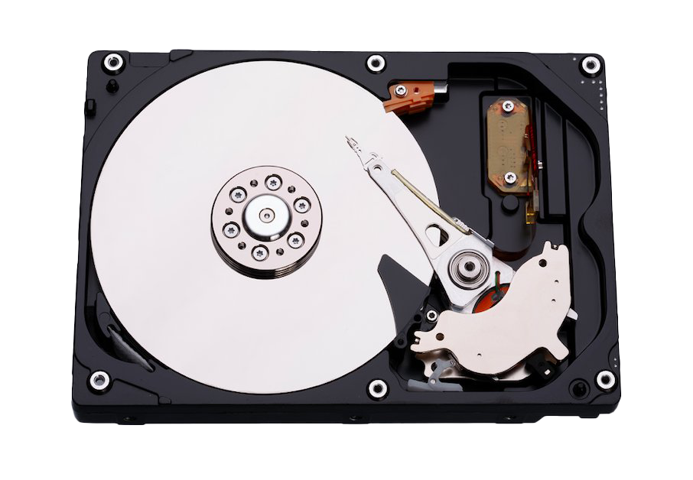
TOPIC 6.1.1 – IDENTIFICATION OF RESOURCES
SECONDARY STORAGE
Secondary Storage - low cost, large capacity, persistent storage
Hard disk drives, Solid State Drives, USB drives, CD, SD Card, etc.
HDDs and SSDs are often used as the main storage drive of a computer

Slide 11
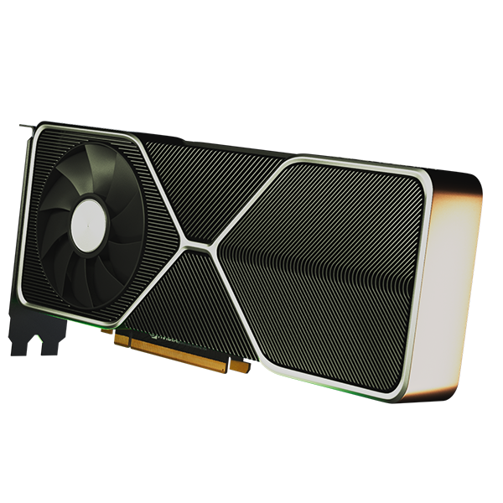
TOPIC 6.1.1 – IDENTIFICATION OF RESOURCES
GRAPHICS PROCESSOR
Graphics Processing Unit (GPU) – designed to render images to the computer’s display
Considered a parallel processor to the CPU
Ideal for running certain kinds of algorithms (AI, video games)

Slide 12
TOPIC 6.1.1 – IDENTIFICATION OF RESOURCES
SCREEN RESOLUTION
The number of pixels that your computer is able to render to the screen is dictated by its resolution
Measured vertically and horizontally
1080p = 1920 pixels wide and 1080 pixels tall
720p = 1280 pixels wide and 720 pixels tall
Pixels are typically rendered by GPU

Slide 13
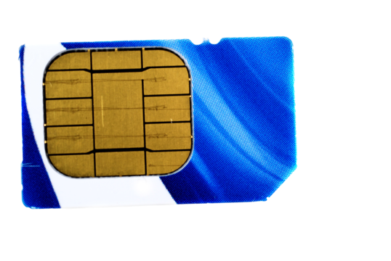
TOPIC 6.1.1 – IDENTIFICATION OF RESOURCES
NETWORK CONNECTIVITY
Most machines come with some form of networking, typically as a feature of the CPU.
A computer may use a Network Interface Card
A phone may require a SIM card to connect to 4G or 5G networks

Slide 14
TOPIC 6.1.2 – AVAILABILITY OF RESOURCES
MACHINE TYPES
Different types of machines require different resources
Mainframes
Supercomputers
Servers
PCs
Laptops
Tablets/Phones
Digital Cameras
What might be differences here?

Slide 15
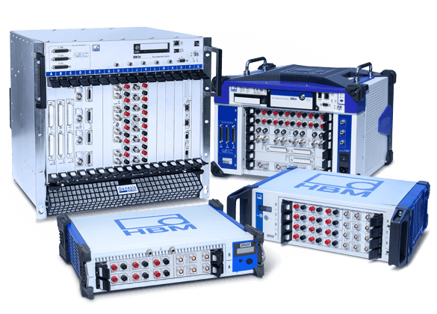
TOPIC 6.1.2 – AVAILABILITY OF RESOURCES
MAINFRAMES
Mainframes – used by large organizations for heavy applications
Government agencies for data crunching
Companies’ large bandwidth communication
Transaction processing
Massive processing power, tons of RAM, bucketloads of storage for data
Lots of different terminals for people to access

Slide 16
TOPIC 6.1.2 – AVAILABILITY OF RESOURCES
SUPERCOMPUTERS
Supercomputers – fast and expensive machines focused on mathematical calculations
Performance measure in FLOPS (floating point operations per second)
Floating point numbers?
Multiple processors working in tandem for maximum power

Slide 17
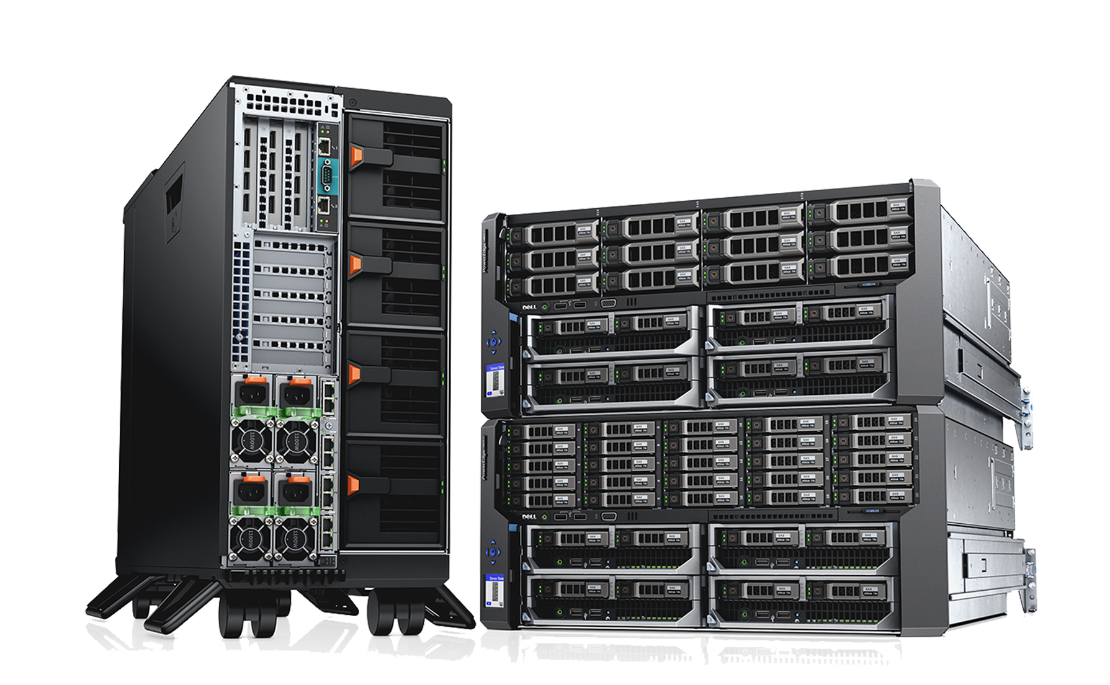
TOPIC 6.1.2 – AVAILABILITY OF RESOURCES
SERVERS
Server – a computer that provides services to clients
Email, Database, File Transfer, etc.
Multiple network connections required
Lots of storage and RAM to service network requests
Fault tolerant with backups

Slide 18
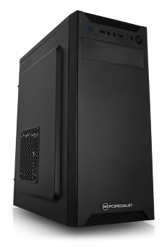
TOPIC 6.1.2 – AVAILABILITY OF RESOURCES
PC
Personal Computer (PC) – inexpensive computer that is capable of running various programs
Typically runs a user focused operating system such as Windows, MacOS, Linux

Slide 19
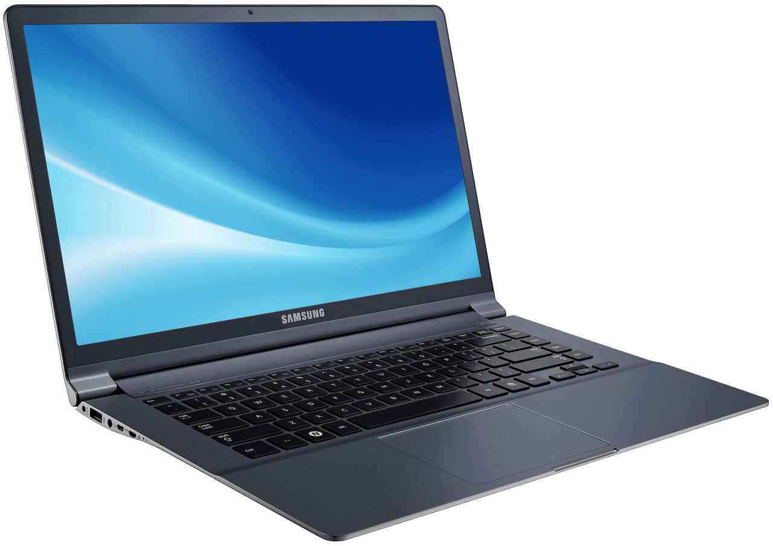
TOPIC 6.1.2 – AVAILABILITY OF RESOURCES
LAPTOPS
Laptops – smaller form factor PC designed to be portable
Run on batteries that need to support hours of computing
Efficiency is more important than raw power
Variety of input methods built in such as mouse, camera, microphone, touch screen, etc.

Slide 20
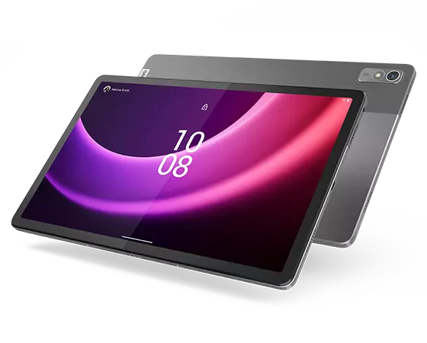
TOPIC 6.1.2 – AVAILABILITY OF RESOURCES
TABLETS
Tablets – mobile computer centered around touch screens
Touch focused operating system and applications
Battery life as a focus
Often come with camera, microphone, Bluetooth, SD card slot, etc.

Slide 21
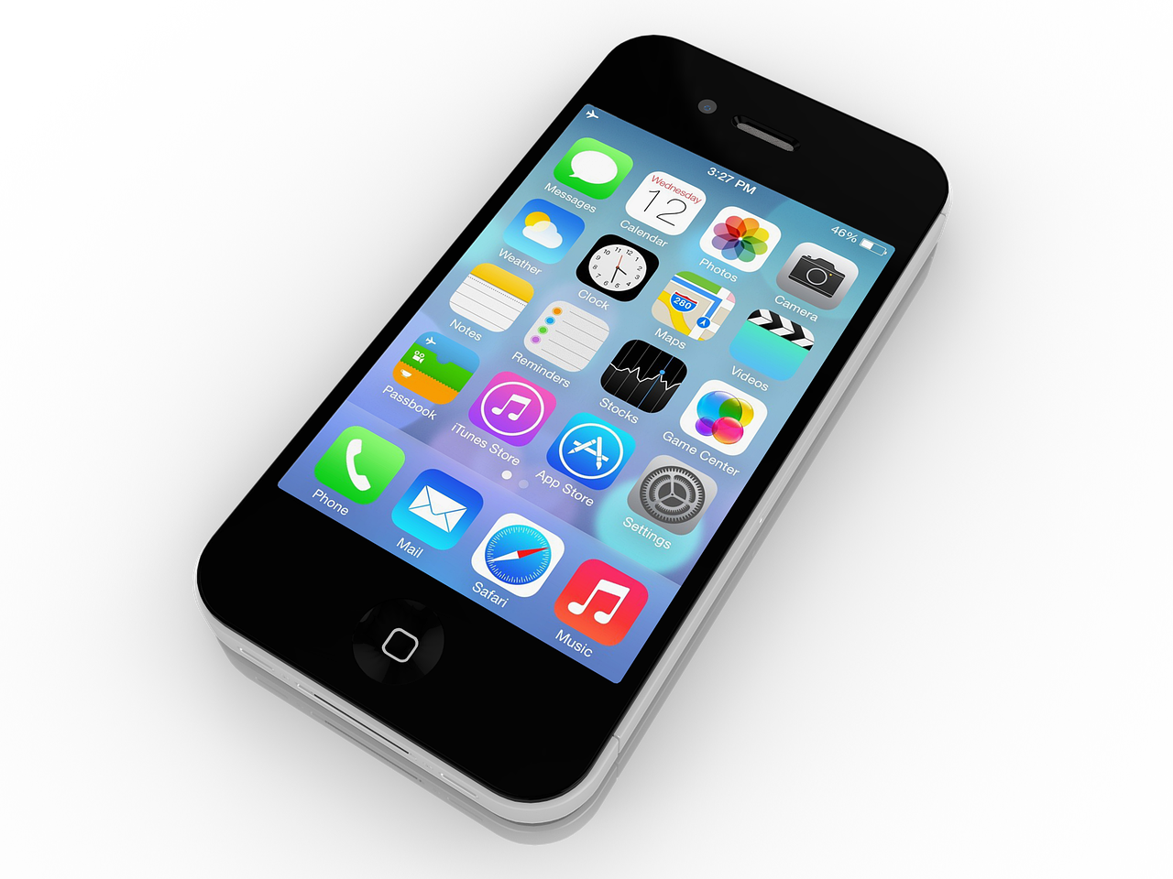
TOPIC 6.1.2 – AVAILABILITY OF RESOURCES
PHONES
Mobile Phones – basically just tiny tablets with cell connectivity
Space inside the device is even more at a premium due to size constraints

Slide 22
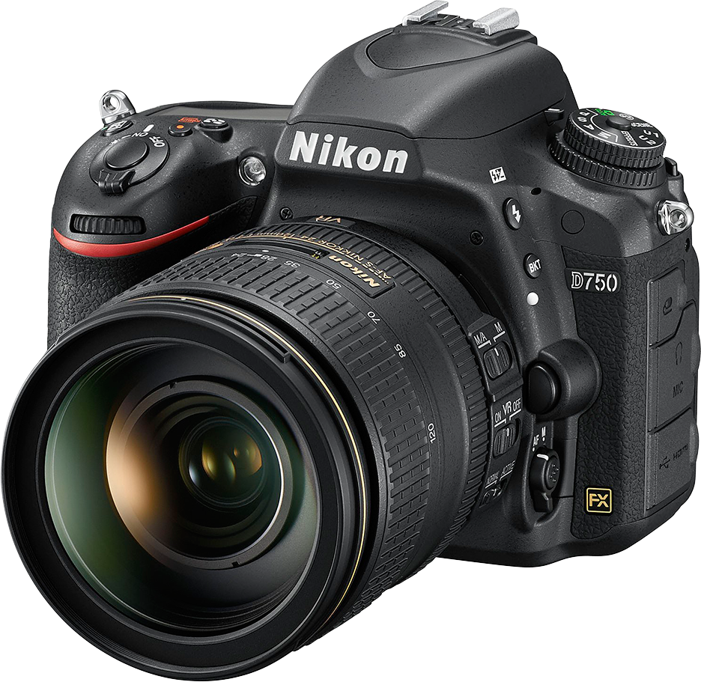
TOPIC 6.1.2 – AVAILABILITY OF RESOURCES
DIGITAL CAMERAS
Digital Cameras – specialized devices for taking photos and videos
Focus on data storage and image processing
Need ports for SD cards, USB, etc.

Slide 23
TOPIC 6.1.3 – LIMITATION OF RESOURCES
LIMITATIONS
Because of the laws of the universe, a computer can only do so much at once
Eventually, requests for resources will likely outpace the availability of those resources
For example, if a computer has 8 GB of RAM, and the operating system takes ~2 GB, you have ~6 GB of memory
You can open more than 6GB worth of programs in memory
When you’re out of memory, the system (depending) may crash or slow down

Slide 24
TOPIC 6.1.3 – LIMITATION OF RESOURCES
RENDERING LIMITATIONS
Another limitation can be seen in CGI
Rendering of movie scenes is often done by applying complex visual and mathematical algorithms to images
State of the art computers take weeks to render these images
They cannot do it in real time
The solution to this is often to chuck more computers at the problem

Slide 25
TOPIC 6.1.3 – LIMITATION OF RESOURCES
CPU LIMITATIONS
A system with a single core processor may have trouble performing demanding tasks
Adding more cores can improve your performance while running one application
Adding more processors improves your ability to run multiple programs at once

Slide 26
TOPIC 6.1.4 – INSUFFICIENT RESOURCES
IN YE OLDE DAYS
Imagine a world where you could only run ONE program at a time
How hard would it be to do an average homework assignment?
How much more time do you think it would take?
This was the reality around ~35 years ago, before modern operating systems

Slide 27
TOPIC 6.1.4 – INSUFFICIENT RESOURCES
MULTIPROGRAMMING
Eventually, a feature was developed to where multiple programs can share the processor - Multiprogramming
Both programs are loaded into memory, but only one can run at a time
Goal is to minimize the time the CPU is sitting idle by passing off CPU control if one program goes idle
Popularized by UNIX, which is the root of MacOS and Linux
Security concerns: can programs access each other’s data? Modify it? No matter what they are less secure.

Slide 28
TOPIC 6.1.4 – INSUFFICIENT RESOURCES
MULTITASKING
Y’know how humans can’t truly multitask? Well, neither can a processor!
What we call multitasking is an improved version of multiprocessing
Rather than gaining complete CPU access, programs send ‘tasks’ to the CPU
These tasks are smaller than the whole program and get completed quicky
The CPU then gets the next task to do
It looks a lot like the computer is actually multitasking

Slide 29
TOPIC 6.1.4 – INSUFFICIENT RESOURCES
MULTIPROCESSING
Multiprocessing – computer hardware with more than once CPU core
A computer with multiple cores can delegate programs or tasks to different cores to truly multitask
A computer can multiprocess and multitask/multiprogram at the same time
Multiprocessing is hardware
Multitasking/multiprogramming is software

Slide 30
TOPIC 6.1.4 – INSUFFICIENT RESOURCES
MULTITHREADING
Multithreading – different parts of a program (threads) are executed simultaneously
Program must be designed to multithread, can’t happen automatically
The GUI of a program and the backend of a program often run on different threads so the GUI feels snappy
The backend can do something more intensive without it feeling sluggish
Multithreading can take advantage of multiprocessing

Slide 31
TOPIC 6.1.4 – INSUFFICIENT RESOURCES
CONSEQUENCES
Without multiprogramming/multitasking we could only run one program at once
This would substantially hinder productivity
Without multiprocessing our computers may get bogged down by having to switch out programs/tasks
This would make each of the many programs you’re running slower
Without multithreading, each program would hang anytime it needed to wait on something like the internet

Slide 32
TOPIC 6.1.2 – AVAILABILITY OF RESOURCES
EXERCISE
For each of the following devices, list what you think a limitation may be
This could be a theoretical limitation, or it can be one that you have yourself run up against
You can only use a limitation once, no repeats!
Laptop
Cell Phone
Server

Slide 33

TOPIC 2.0 – COMPUTER ORGANIZATION
VOCAB TO REMEMBER
Bandwidth
Multiprogramming
Multithreading
Multitasking
Multiprocessing
Hertz

